Slide 1
LECTURE NOTES ON CONTINUA MECHANICS
Robert Nigmatulin
nigmar@ocean.ru

Slide 2
THEORETICAL MECHANICS = Mechanics of
Material Points or point particles
(no size, only mass)
2. Rigid bodies (no deformation)

Slide 3
Astronomy scales and
conception of material point
SUN
D = 1,39 x 10⁶. km
L_{cos} = 1000×10⁹ km
150 x 10⁶. km
Moon
L = 3x10⁹ km
384 x 10³ km
EARTH+Moon
D = 0,77 x10⁶ km
Earth
D = 12,7x10³ km

Slide 4
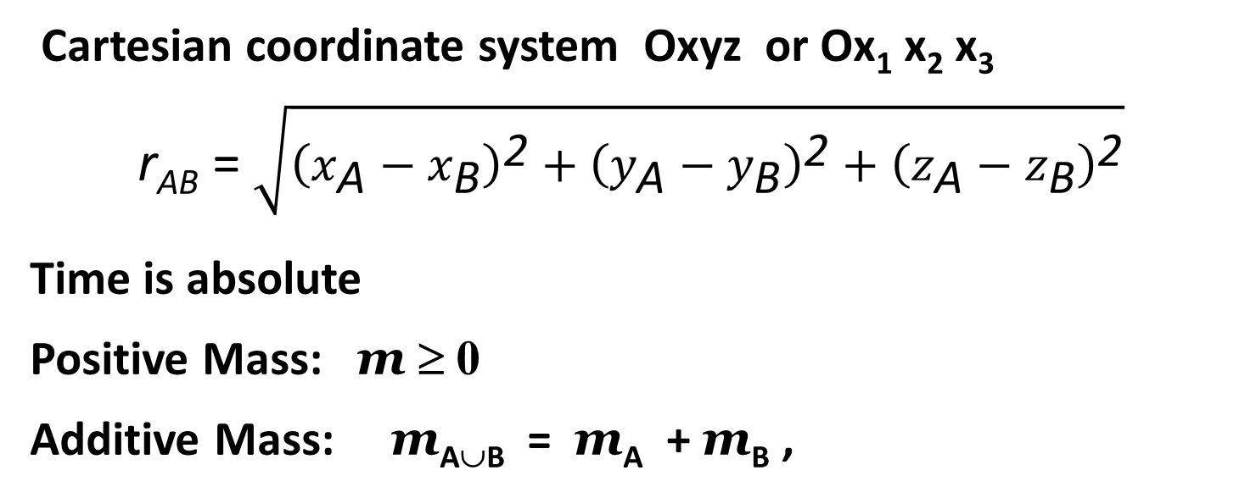
CLASSICAL (EUCLIDIAN OR NEWTONIAN) CONCEPTION of SPACE
Cartesian coordinate system Oxyz or Ox₁ x₂ x₃
r_{AB} = $\sqrt{{\left(x_{\text{A}}−x_{\text{B}}\right)}^{\text{2}}+{\left(y_{\text{A}}−y_{\text{B}}\right)}^{\text{2}}+{\left(z_{\text{A}}−z_{\text{B}}\right)}^{\text{2}}}$
Time is absolute
Positive Mass: m ≥ 0
Additive Mass: m_{A∪B} = m_{A} + m_{B} ,
1 A = 10⁻¹⁰ m << L < L_{cos} ∼ 10¹⁵ = 10¹² km,
v << C = 299 792 458 m/s = 3 × 10⁸ м/s = 3 × 10⁵ km/s

Slide 5
GALILEO POSTULATE
Physical Laws are invariant in any inertial coordinate system

Slide 6
CONTINUUM MECHANICS =
= Mechanics of deformable bodies
(change in dimensions or density, compression, twist, shear) or flow
Gas, Fluid, Liquid, Solid Bodies, Constructions

Slide 7
Hypothesis (Assumptions) of continuity
All characteristics of material objects can be represented by
continuously differentiable functions
of three coordinates and time as
f(x, y, z, t) or f(x₁, x₂, x₃, t)
(density, velocity, displacement, temperature, pressure, stress, etc.)
Exception of singular points, curves, and surfaces, which should be considered separately

Slide 8

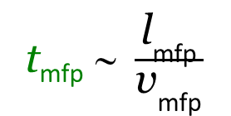
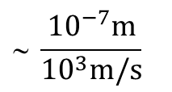
Concept of CONTINUOUS MEDIUM (continuum)
Pile of sand, (Sand particle δ_{particlel} ∼ 1 mm consists of N′ ∼ 10¹⁹ molecules)
1 spoon of sand (3 cm³) consists of ∼ 2000 sand particles
2. Gas, р ∼ 1 bar, Т ∼ 300 K,
N ∼ 10¹⁹ cm^{–3}
l_{mfp} ∼ 10 ^{–5} cm = 100 nm, d_{mol} ∼ 10^{–8} cm = 10^{–1} nm
t_{mfp} ∼ $\frac{{\text{l}}_{\text{mfp}}}{{\text{v}}_{\text{mfp}}}$
$$ \frac{{10}^{−7}m}{{10}^{3}m/s}$$
$$=\text{1}{\text{0}}^{−10} \text{s} \text{=1}{\text{0}}^{−1}\text{ns}$$
3. Condensed phases (liquids and solids) N ∼ 10²²–10²⁴ cm^{–3},
l_{mol} or lattice spacing l_{crystal} ∼ l_{mol} ∼ d_{mol} ∼ 1 A = 10⁻¹ nm.
(δ_{hair} = 20 – 30 μm = (20 – 30)×10³ nm)
1 nm = 10^{–9} m = 10^{–7} cm = 10^{–6} mm = 10^{–3} μm = 10 A

Slide 9
Moon atmosphere?
N = 10⁸ - 10⁹ cm⁻³ - molecular number density
l_{mfp} ∼ 10 m – mean free path

Slide 10

AVERAGE (MACROSCOPIC) VALUES
− Center of the volume
(δV ∼ (δr)³).
x₃
$$\text{δ}V$$
M
x₂
x₁

Slide 11
M
Δ
Δ
Δ
Δ

Slide 12
THOUGHTFUL (mental) EXPERIMENT
l_{micro} << δr << L,
δN >> 1,
∼ l_{microt}
Δ_{min}
Δ_{max}
∼ L
δr
1. l_{micro} << Δ_{min} << Δ_{max} << L − Plateau or Stability

Slide 13
2. Representative
For any volume
3. Regular
L >> Δ_{max},
Definition. A continuously differentiable function ρ(x, t) whose spatial derivatives have an upper bound on the order of ρ₀/L is said to be regular over the length scale L.

Slide 14
1. l_{micro} << Δ_{min} << Δ_{max} << L - Plateau or Stability
- wide interval of averaging volume size δr
2. Representative
3. Regular
L >> Δ_{max},

Slide 15
Regularity or smoothness for all variables

Slide 16
Material Point (material particle) and Fields
in Continuum Mechanics
x₃
M
1. Point M
2. δV = O((δr)³
3. l_{micro} << δr << L
x₂
x₁
4. Axiom of particle identity.
Each individual material point (particle) in a continuous medium (continuum) preserves its identity
L >> δr >> l_{mfp}
If not one needs to use Boltzmann equtions

Slide 17
What does it mean the particle identity?
Each individual material point (particle) in a continuous medium (continuum) preserves its identity; i.e., the position of any particle can be determined at any instant as
r = r(t) (r → (x₁, x₂, x₃, t)),
given its position at reference time:

Slide 18
A few macroscopic variables
instead of
a huge number (∼ N) of microscopic ones
of Molecular Dynamics
↓
Additional hypotheses and equations, empirical laws, and possibly some theorems of probability theory or statistics
Equations of State, Hooke’s Law, Navies-Stocks Law
Thermodynamics
Statistical Theory (Boltzmann Equations), …..

Slide 19

Lagrangian Description of Motion of Continuous Medium
x₃
Inertial observer’s (resting and Cartesian)
w
r = r(x₁, x₂, x₃)
e₃
t = $\hat{t}$:
e₂
x₂
e₁
x₁

Slide 20
All these three functions are
continuously differentiable and
single-valued functions
Identifiers (ID) of the particle,
they remain unchanged during its motion.
Initial conditions

Slide 21
All these three functions are
continuously differentiable and
single-valued functions
Identifiers (ID) of the particle,
they remain unchanged during its motion.

Slide 22
Nonzero Jacobian of the transformation of the variables
Definition. A set of variables and ξ₁, ξ₂, ξ₃ identifying individual particles is referred to as Lagrangian coordinates.
ξ₁, ξ₂, ξ₃ – Curvilinear Lagrangian coordinates

Slide 23



COMOVING COORDINATE SYSTEM (curvelinear)
x₃
ξ₂
r = x₁e₁ + x₂e₂ + x₃e₃
ξ₃
e₁ =
ξ₃
ξ₁
ξ₂
w
e₂ =
ξ₁
e₃
Comoving
(curvilinear)
e₃ =
t = $\hat{t}$:
e₂
x₂
e₁
Inertial observer’s (resting and Cartesian)
x₁
Comoving
(curvilinear)
$\hat{r}$ = $\hat{r}$(ξ₁, ξ₂, ξ₃, t)
t = 0:
$r^{∘}$= $r^{∘}$(ξ₁, ξ₂, ξ₃, t)

